Slide 1

Auto-IA Workshop HMTM Hannover
TOPIC MODELING FOR SOCIAL SCIENTISTS
Model selection and evaluation
Gregor Wiedemann | g.wiedemann@leibniz-hbi.de
Media Research Methods Lab
Leibniz-Institute for Media Research | Hans-Bredow-Institut
Andreas Niekler | aniekler@informatik.uni-leipzig.de
Abteilung Automatische Sprachverarbeitung, Institut für Informatik
Universität Leipzig

Slide 2
This lecture
Model selection and evaluation
  Manual approaches
  Numeric approaches
Variants of topic models
  HDP
  sLDA
  ATM, CTM, RTM, STM

Slide 3
Model selection and evaluation

Slide 4
Computer-assisted Text Analysis
Use of Text Mining is of no end in itself for qualitative data analysis
instead TM procedures should to be
  embedded into a methodological framework
  selected in accordance with the research question
  applied in a thoughtful systematic analysis workflow
  run with optimal parameters regarding the data
  carefully evaluated w.r.t. to the research goal

Slide 5
Compatibility of Text Mining and QDA
„4 Principles of Automated Text Analysis“ (Justin Grimmer 2013)
  1. All Quantitative Models of Language Are Wrong—But Some Are Useful
  2. Quantitative Methods Augment Humans, Not Replace Them
  3. There Is No Globally Best Method for Automated Text Analysis
  4. Validate, Validate, Validate
Blended reading:
  systematic combination of distant reading interpretations with close reading validation of findings (Lemke/Stulpe 2015; Lewis et al. 2013)

Slide 6
Model selection and evaluation
2 closely linked goals: selection and evaluation of models
  selection: finding best model and parameters to fit a model with respect to the data
    reference: models against each other
  evaluation: procedure to determine / measure the quality of a model
    reference: absolute quality criteria
2 ways of quality assessment / validity check:
  qualitative evaluation: human judgement on model results
  numeric optimization: algorithmic judgement

Slide 7
Model selection and evaluation
raf, terrorist,
mord, baader,
bka, fahndung,
buback, ensslin
stammheim
terrorist, raf,
schmidt, baader,
haus, fahndung,
jahr, politik,
polizei, bka
2 closely linked goals: selection and evaluation of models
  selection: finding best model and parameters to fit a model with respect to the data
    reference: models against each other
  evaluation: procedure to determine / measure the quality of a model
    reference: absolute quality criteria
2 ways of quality assessment / validity check:
  qualitative evaluation: human judgement on model results
  numeric optimization: algorithmic judgement
f(M₁) = 0.78
f(M₂) = 0.56

Slide 8
Quality criteria
Objectivity:
  if model assumptions of the generative process of text origin hold true, algorithmic solution guarantees maximum intersubjectivity
Validity:
  model caputures semantic coherence prominent in and relevant for a text collection properly
Reliability:
  repeated runs of model inference with same parameters on the same data produce same (or at least similar) results

Slide 9
Challenges
Topic models ~ semantic clusters of document collections
Validity:
  Evaluation of clustering as heuristic instrument is generally hard
  Example: divide the following 2 lists each in 2 clusters:
    A) ostrich, penguin, wale, zebra
    B) grandson, granddaughter, grandmother, grandfather
Reliability:
  Stochastic process for model inference -> only nearby, not exact solutions!
Model selection: find model parameters resulting in valid and reliable models

Slide 10
Challenges
Human
judgement
Topic models ~ semantic clusters of document collections
Validity:
  Evaluation of clustering as heuristic instrument is generally hard
  Example: divide the following 2 lists each in 2 clusters:
    A) ostrich, penguin, wale, zebra
    B) grandson, granddaughter, grandmother, grandfather
Reliability:
  Stochastic process for model inference -> only nearby, not exact solutions!
Model selection: find model parameters resulting in valid and reliable models
Numeric
evaluation

Slide 11
Manual evaluation
3 steps proposed by Evans (2014):
  1) check semantic coherence of top N terms of each topic: Can you assign a topic label?
  2) employ additional numeric measures of topic coherence to identify broad / incoherent topics
  3) check if topic distribution over time complies with researcher intuition
2 methods introduced by Chang et al. (2009):
  Word intrusion
  Topic intrusion
1 tool for visual analysisby Sievert (2014): LDAvis
  Nearness of topics (using PCA)
  Re-Ranking of topic terms

Slide 12
Manual evaluation
3 steps proposed by Evans (2014):
  1) check semantic coherence of top N terms of each topic: Can you assign a topic label?
  2) employ additional numeric measures of topic coherence to identify broad / incoherent topics
  3) check if topic distribution over time complies with researcher intuition
2 methods introduced by Chang et al. (2009):
  Word intrusion
  Topic intrusion
1 tool for visual analysisby Sievert (2014): LDAvis
  Nearness of topics (using PCA)
  Re-Ranking of topic terms

Slide 13
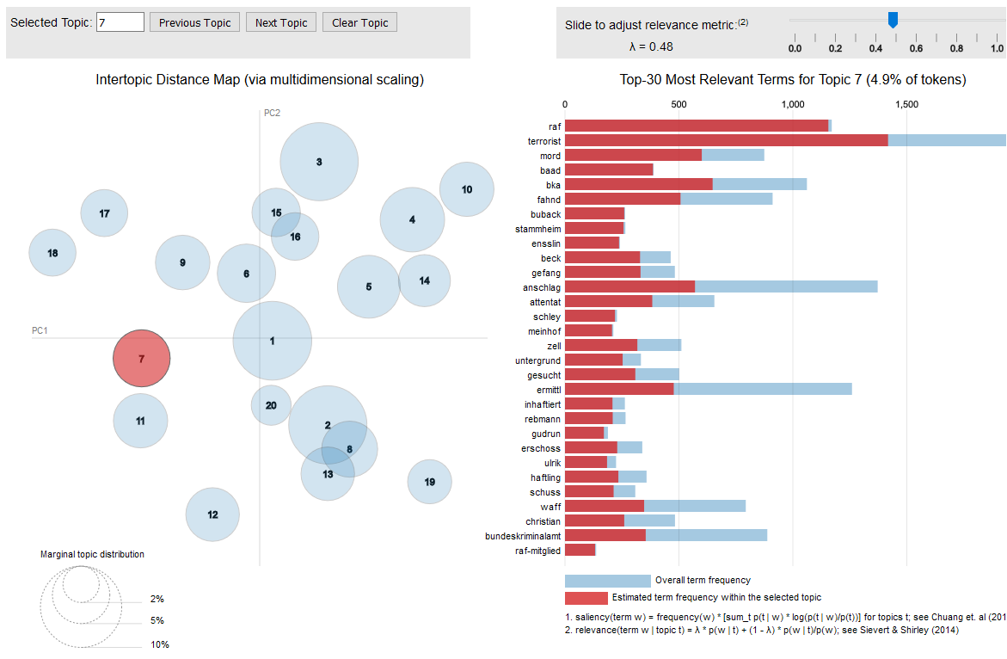
LDAvis

Slide 14
LDAvis
label:
RAF terrorism

Slide 15
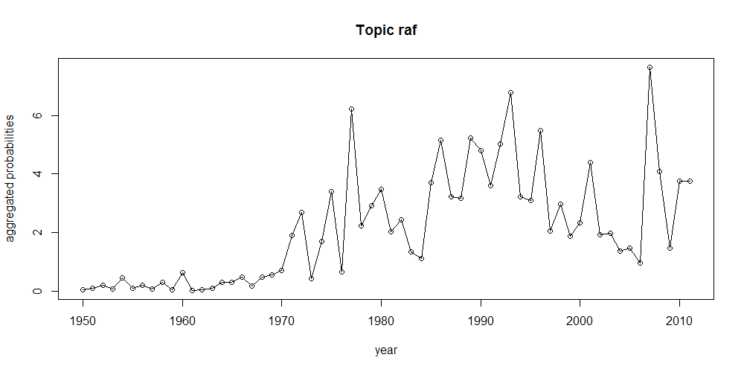
Time series
Option 1: Aggregate probabilities by time period
Option 2: Count documents per time period containing a certain topic
Compliance with researcher intuition?

Slide 16
Word intrusion
Idea Chang et al. (2009):
  top topic words should represent semantic coherence; coherence could be evaluated by finding inappropriate intruder term
Experiment:
  repeat n times for random topic k
    create top word list L for topic k
    choose intruder term t not in top words of k, but relevant in other topic
    put intruder word into shuffled L
    ask evaluator to find t in L
  calculate correct guesses / n
raf
terrorist
uhr
mord
baader
bka
raf
terrorist
uhr
mord
baader
bka

Slide 17
Topic intrusion
D4: TERRORISTEN|Vor dem
Oberlandesgericht Düsseldorf
muß sich die mutmaßliche
Terroristin Angelika Speitel
wegen Mordes verantworten.
Es geht auch um Beteiligung
an der Ermordung von Bu-
back, Ponto und Schleyer.
[...]
Idea: read document (or at least beginning of it) and find intruded topic from presented list
  sample document d
  get 3 most prominent topics in d
  select 1 topic not prominent in d
  let user choose suspected intruder from shuffled list
T1: raf, terrorist, mord, baader, bka
T2: polizei, daten, burg, vs, hamburg
T3: deutsch, muslim, islamist, anschlag
T4: gericht, jahr, richt, verfahren, vs

Slide 18
Word / topic intrusion
(Dis-)Advantages:
  + provide substantial numeric measures in range [0,1]
  + allows for comparison of models against each other
  - large effort for substantial evaluations of multiple models
  - human evaluators perform different in this task
  - aspired quality not clear (~0.7 cp. to inter-rater reliability in content analysis?)

Slide 19
Numeric evaluation
Goal: Entirely automatic approaches to judge on model quality
→ determine model quality in one numeric measure
3 Approaches:
  Perplexity (Wallach et al. 2009)
    How well performs generalization of a learned model to unseen data?
  Coherence (Mimno et al. 2011)
    How often do we oberve predicted semantic coherence actually in the data?
  Reliability (Lancichinetti et al. 2015, Koltsov 2012, ...)
    How reproducible are model results between repeated inference runs?
CAUTION: None of them replaces careful manual inspection!

Slide 20
Perplexity
Perplexity:
  surprise of the model, when presented with new data -> a.k.a „Held-out Log Likelihood“
  What is the probality of the words in a test documents under the pre-trained model?
Assumption:
  The lower the perplexity, the better model captures semantic coherence in the collection
Model
train
test
D_{u}
D_{i}

Slide 21
Perplexity
Variant: Document completion
  Use X % of document content for training and remaining 100 – X % for testing
Model
train
test
D_{i}
D_{i}
D_{i}

Slide 22
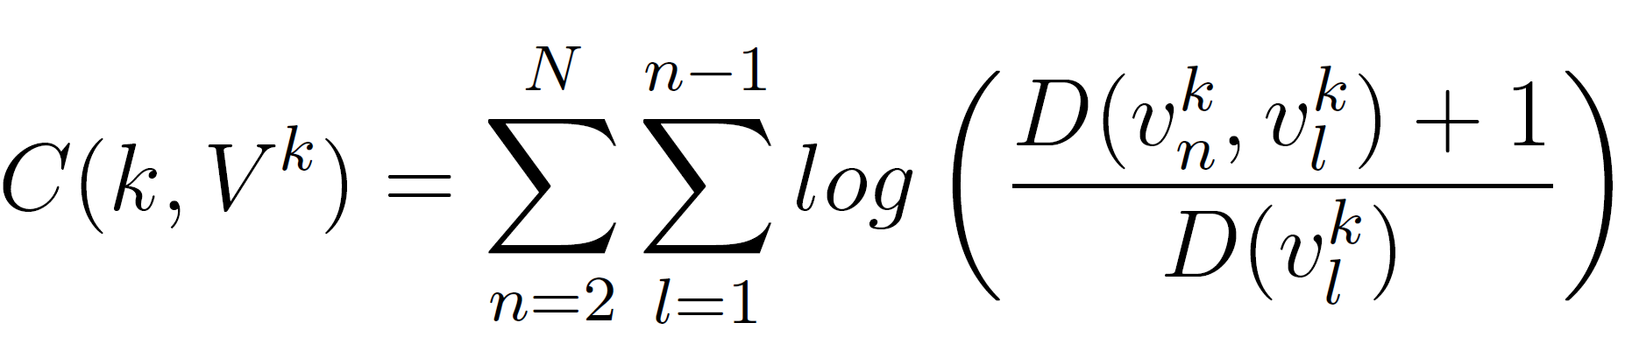
Topic Coherence
Chang et al. (2009):
  large user studies with word intrusion and topic intrusion
  low perplexity does not correspond well with user perecption of coherent topics
Mimno et al. (2011):
  Idea: measure co-occurrence of highly-probable topic terms in documents instead of perplexity
  The higher the coherence, the better the model captures actual semantics
  Higher correlation of the coherence measure with user perception than perplexity
raf
terrorist
mord
baader
bka
k – topic k
V^{k} – top N words
of topic k
D(t)– number of
documents
containing t
raf
terrorist
mord
baader
bka
...
bka
baader
bka
raf
mord
terrorist
...
raf
mord
…
...
raf
terrorist
mord
baader
bka
k

Slide 23
Perplexity / coherence
(Dis-)Advantages:
  + provide substantial numeric measures in range
  + allows for comparison of models against each other
  + coherence allows for assessment on single topics k, and entire models → mean of coherence(k) for all k in 1:K
  – no bounded value range → no absolute comparison
  – high coherence seems to correlate with low priors → overfitting
  – as single optimization goal they miss the goal of inference of good models too!

Slide 24
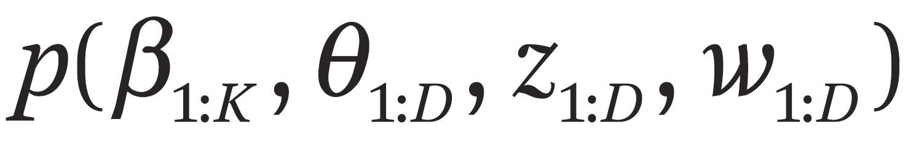
Reliability (a.k.a. stability)
numerous local optima of
solution possible only via stochastic inference
→ random sampling → results near optimal solution, but varying in probability space
depending on
– parameter initialization
– sampling strategy
between repeated inference may vary greatly
quality criterion in social science: determine reliability of measurement instruments!

Slide 25
Reliability
Idea:
  compare pairs of models of repeated inference runs
  measure similarity of results, e.g. how many topics can be reproduced reliably
Challenges:
  identification of matching topic pairs ← no stable identifier due to stochastic inference process
  definition of similarity: when are topics considered „equal“
State-of-the-art:
  problem identified in social science (e.g. Lancichinetti in 2015)
  Approaches:
    Roberts et al. 2016 (STM): Spectral Clustering for initialization + Random Seed fixation, fully reproducible
    Maier et al. 2018 (LDA): LL-Co-occurrence Clustering for initialization, increased stability
    Rieger 2020 (LDA): ldaProtoype, select the LDA run from N = 100 runs with highest mean pairwise similarity

Slide 26
Reliability
2 types of approaches two compare two models
m₁ = (β_{1:K}, θ_{1:D}) and m₂ = (β'_{1:K}, θ'_{1:D})
Approach I: matching topics topic-term-distributions β:
  choose similarity measure SIM and define similarity threshold s
  similarity measures:
    Kullback-Leibler-Divergence (KLD), Jensen-Shannon-Divergence (JSD) (Koltsov 2012)
    Cosine Similarity on top N topic words (Niekler 2015)
  for each β_{k} find most similar β'_{k} where SIM(β_{k}, β'_{k}) > s

Slide 27
Reliability
compare two models m₁ = (β_{1:K}, θ_{1:D}) and m₂ = (β'_{1:K}, θ'_{1:D})
Approach II: matching topics by document-topic-distributions θ
(Lancichinetti 2015):
  topic distribution given document p(k|d) from θ and θ' cannot be compared directly due to unknown topic matching → Idea:
    compare p(d|k) because document indexes are fixed and known
    p(d|k) can be obtained via Bayes' Rule: p(d|k) = p(k|d) * p(d) / p(k)
  calculate manhattan distance on p(d|k) and p(d|k') for all topic pairs from m₁ and m₂ and match least distant topics (best match)
  correct for distance obtained by randomly sampled topic distribution over documents
  Reliability score = average chance corrected manhattan distance between matched pairs

Slide 28
Reliability
(Dis-)Advantages Approach I (comparing β and β'):
  + provides measure in range [0;1]
  + follows analysts intuition of comparing semantic coherence of terms
  + especially cosine distance concentrating on top topic terms
  – measuring similarity with KLD or JSD for comparing probability distributions (information loss) is less intuitive
  – measures need to assume theresholds for similarity -> high influence on reliability score
  – cosine measure also need parameter N for top topic words to match

Slide 29
Reliability
(Dis-)Advantages Approach II (comparing θ and θ'):
  + provides measure in range [0;1]
  + does not rely on thresholds for comparison
  + chance correction
  +/– considers unequal importance of topics by weighting distance with overall topic probability
  – no bipartite matching of pairs from m₁ and m₂ guaranteed
  – Manhattan distance on probabilities less intuitive
  – rather conservative scoring of reliability

Slide 30
Increasing reliability
Reducing K:
  lowered number of topics → more stable clusterings
Fixed initialization of topic assigments to words z before/during Gibbs sampling
  Seed: random, but fixed initialization (does this really improve model reliability?)
  Clustered: using term co-occurrence clusters as informed prior for fixed initialization
    Variant 1: „Topic Mapping“ by Lancichinetti et al. 2015: initialize z by term co-ooccurrence clusters of documents in the collection; run Topic Model inference for only 1 iteration → Reliability = 1 (but: it is actually not longer topic modeling…)
    Variant 2: run Topic Model inference for N iterations → Reliability < 1, but still improved (next slide)
  Change sampling process as suggested by Koltsov 2012: force sampled topic for word w onto its left and right neighbors -> co-occurring words tend to have same topic; But:no straightforward implementation on bag-of-words representations in R
Pragmatic approach:
  Leave out unreliable / in incoherent topics in final analysis

Slide 31
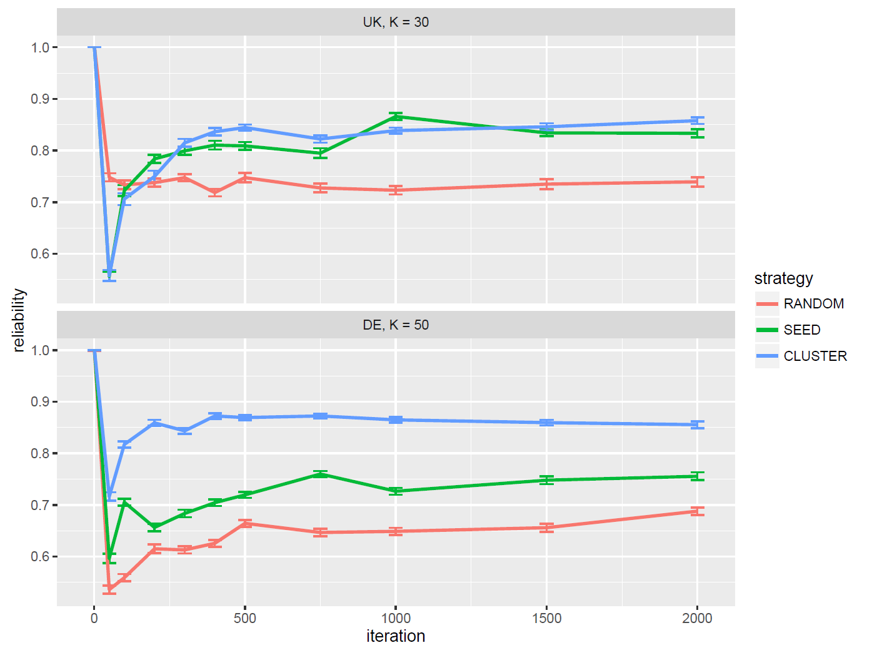
Increasing reliability

Slide 32
Best Practice Suggestion (Maier et al. 2018)
General advice:
  avoid model selection solely based on numeric evaluation measures (!correspondence with human judgement)
  make theoretically sound selections insteand and check manually
Workflow:
  1. Preprocessing: clean documents/remove biolerplate, lowercase, remove punctuation, remove stop words, remove infreqent terms (df(w) < 0.5 % document frequency), lemmatization/stemming
  2. (initialize topic assignments for LDA)
    a) set seed, or
    b) cluster terms by their co-occurrence statistics
  3. Compute a variety of models with different parameters K, alpha, (fix eta = 1 / K)
    1. for each K, select model with alpha wih highest topic coherence
    2. select model with best interpretable K topics (use LDAvis as helper tool)
  4. Validate selected model
    rank words: term probability + lambda relevance score (LDAvis) → interprete semantic coherence → label
    rank topics: topic probability + rank1 (background vs major topics), coherence (compared to other topics)
    read N documents for each topic with highest topic probability
    check reliability to repeated inference runs
  5. Final analysis: time series, cross-sectional analysis
    leave out uninterpretable models
    leave out unreliable models

Slide 33
END

